Slide 1


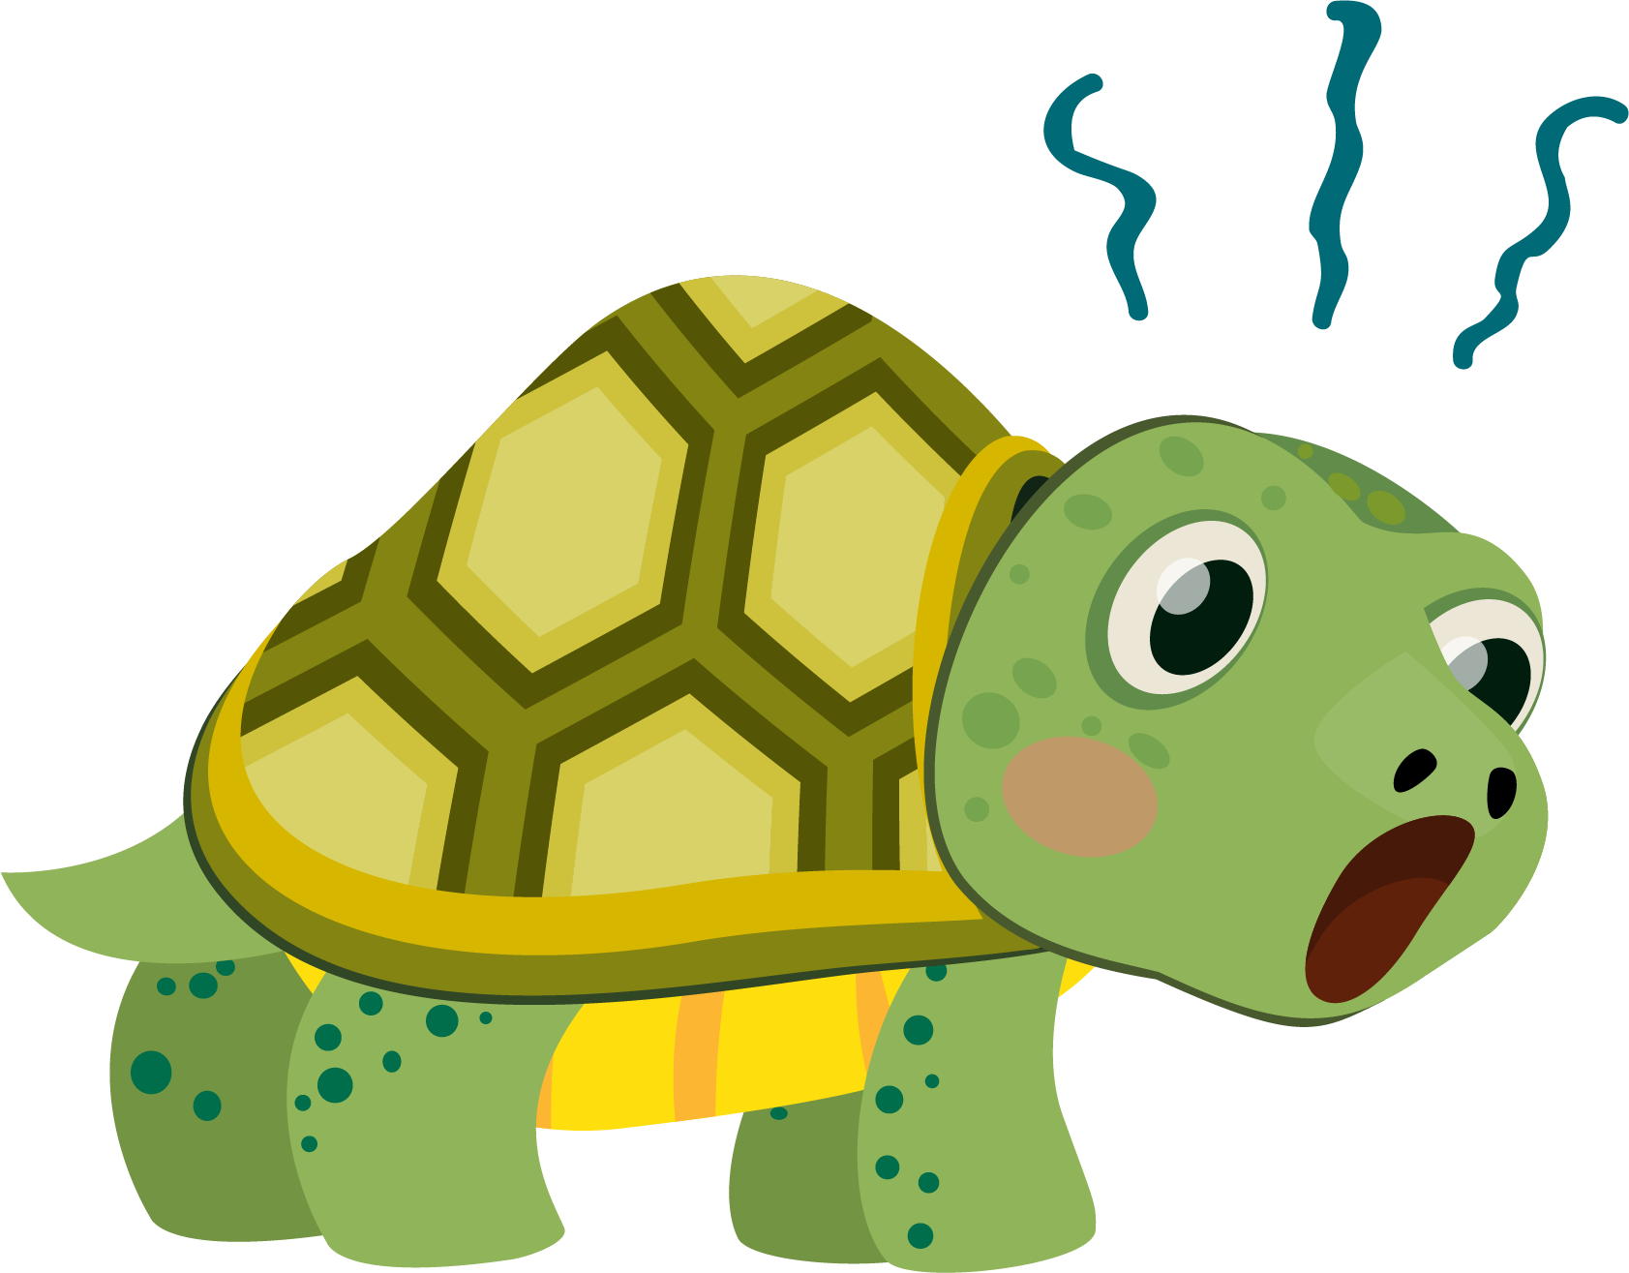
Lesson 6:
Turtle Crossing

Slide 2
Slide

Slide 3
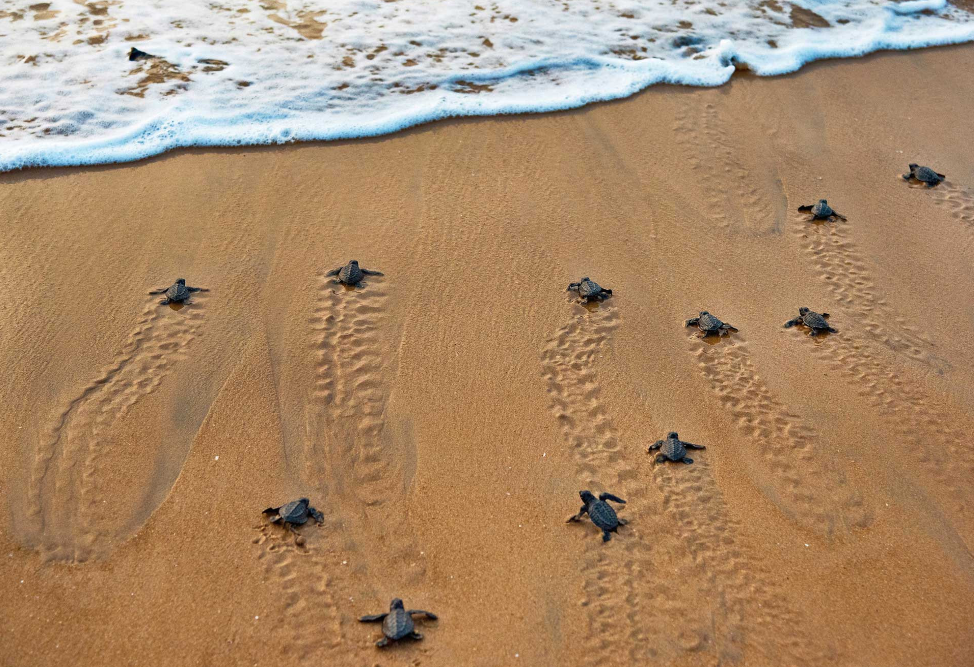
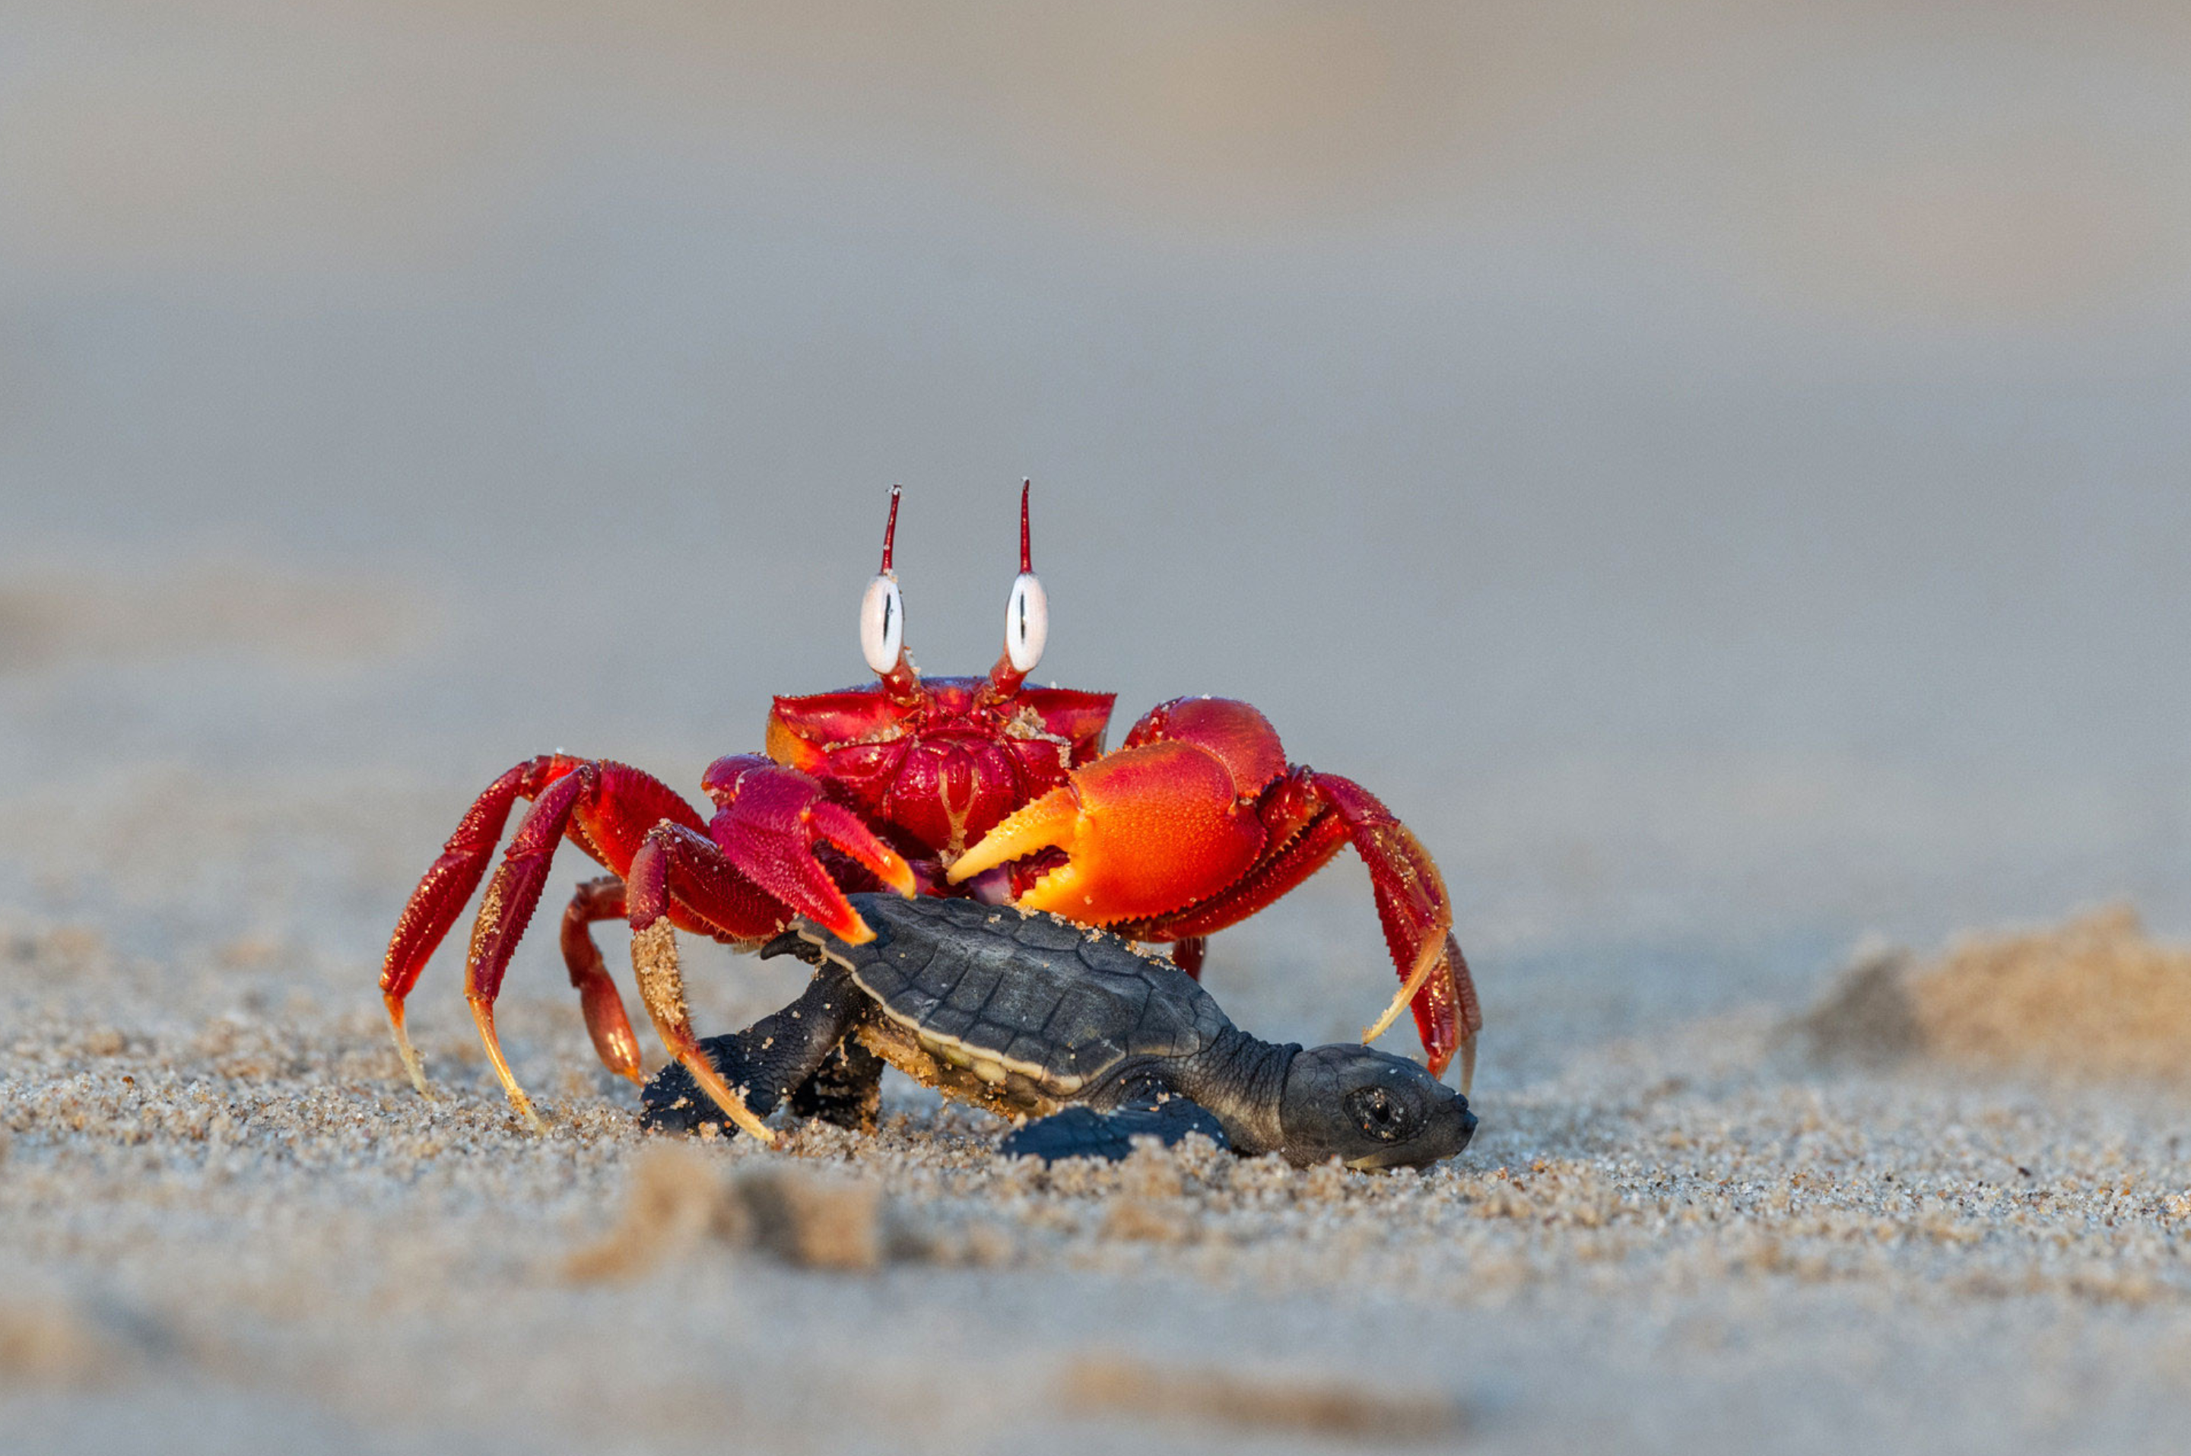
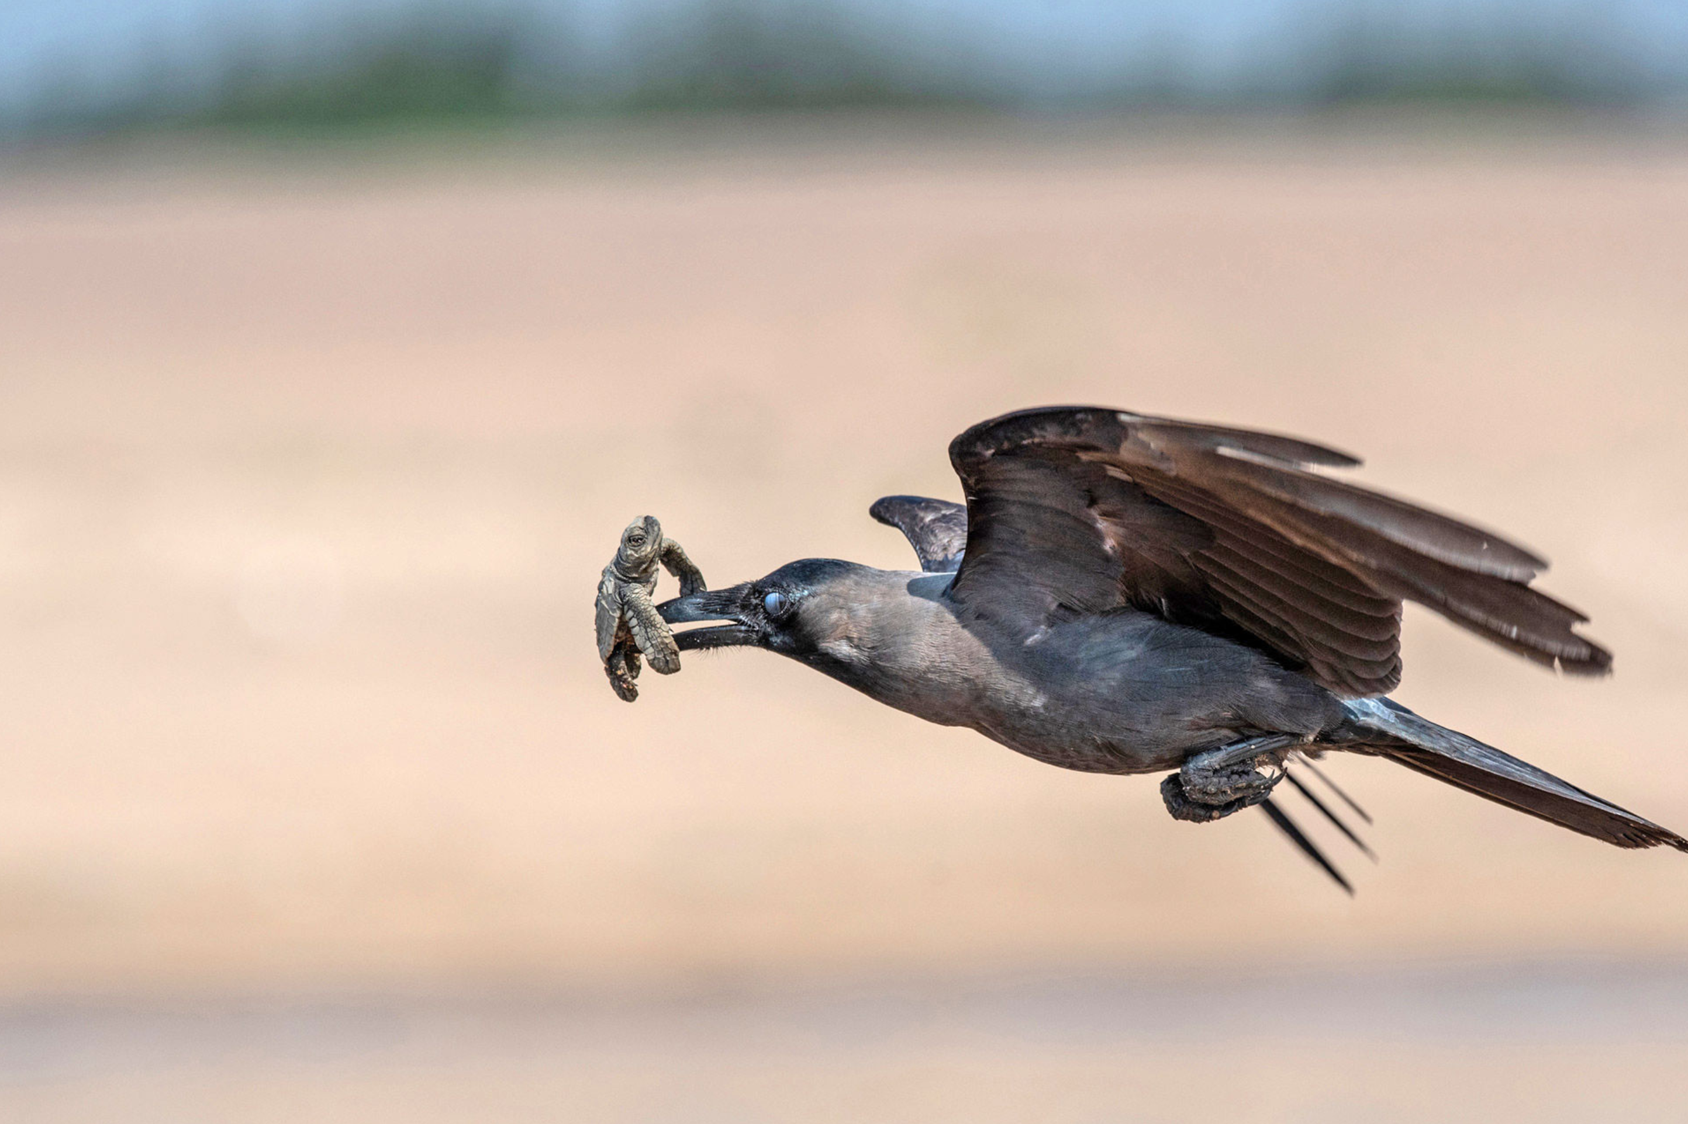
Dangerous Journey…

Slide 4



Turtle Crossing

Slide 5

Pick a Local Backdrop
Scratch for Newbies
Level1
Lesson 6 – Turtle Crossing
Resources
Backdrop
beach.png

Slide 6
Pick a Local Turtle
Scratch for Newbies
Level1
Lesson 6 – Turtle Crossing
Resources
Sprites
turtle.png

Slide 7
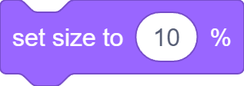

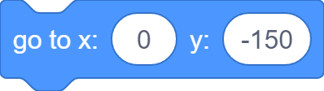
Set Turtle Up

Slide 8
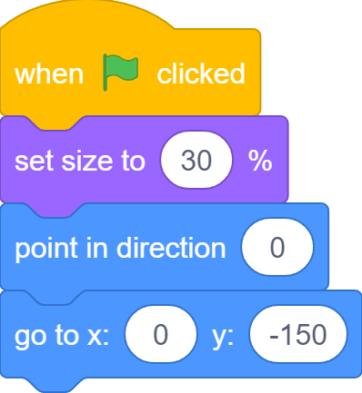
Set Turtle Up

Slide 9
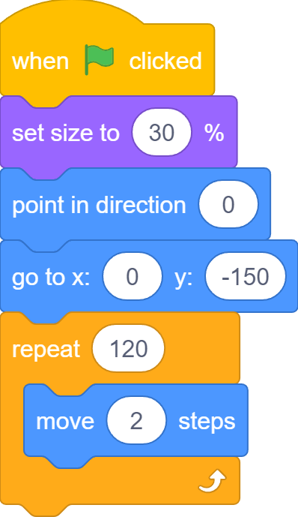
Move to Ocean

Slide 10
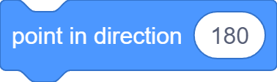
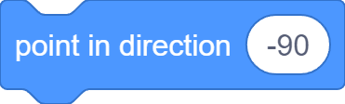
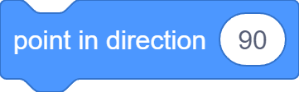
Change Turtle Direction

Slide 11

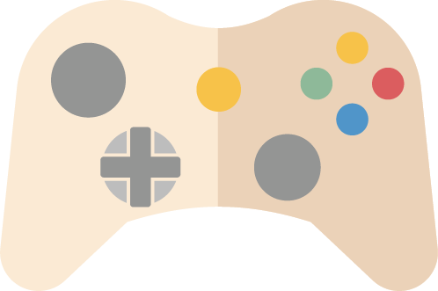

Game Controls

Slide 12




Control Turtle Direction

Slide 13
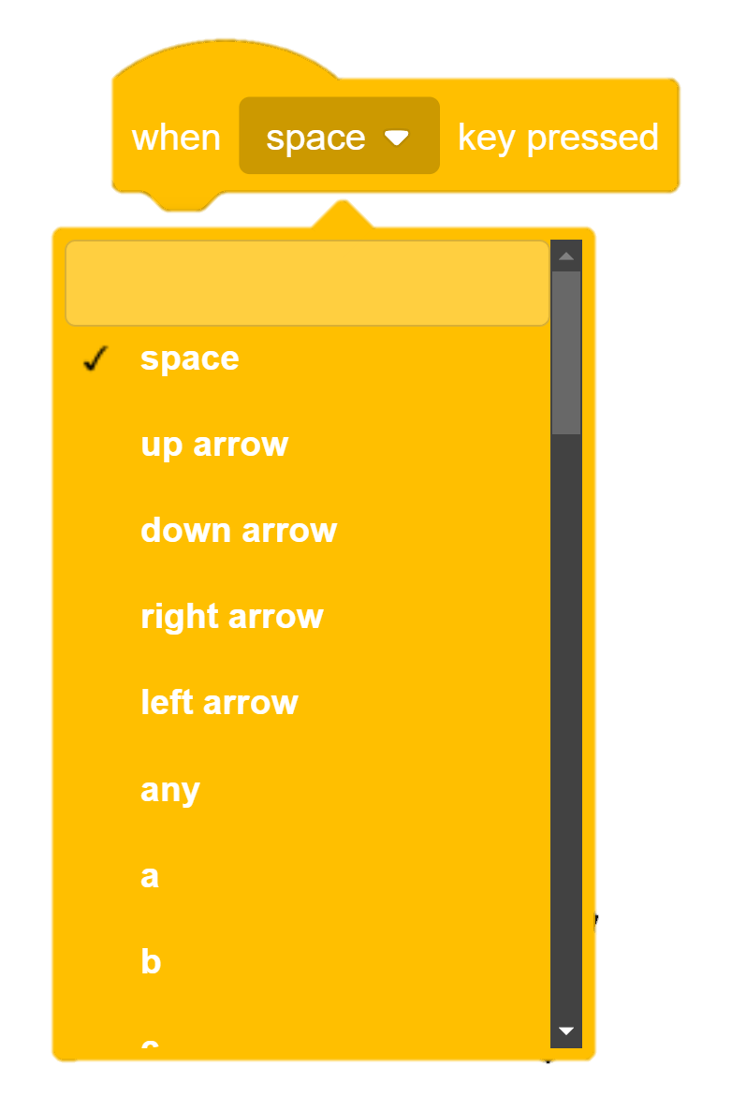
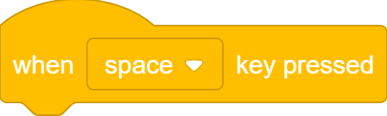
When Key Pressed…

Slide 14
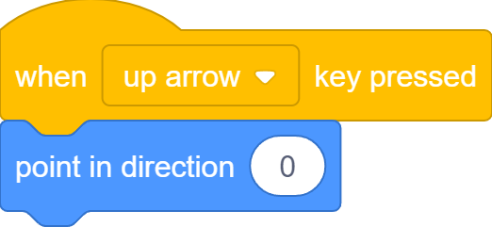
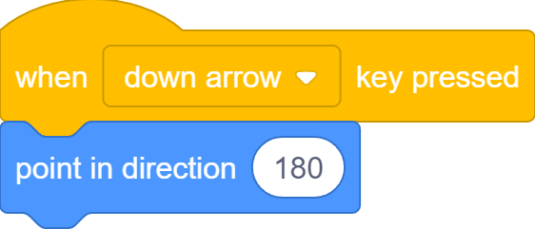

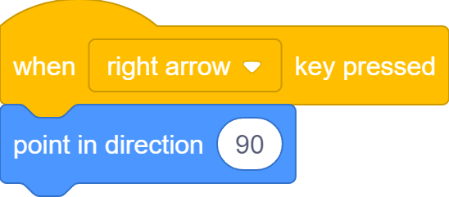
When Key Pressed…

Slide 15
Move to Ocean

Slide 16

Stop Somewhere
But sometimes, turtle stops before reaching the ocean…

Slide 17
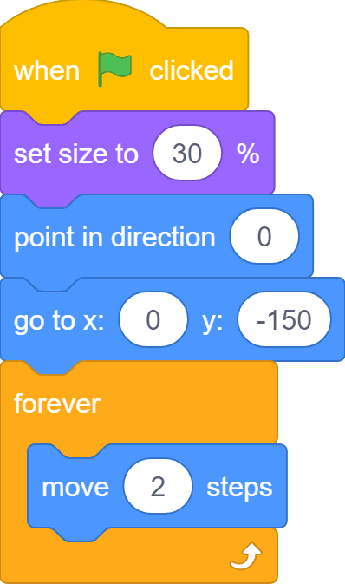
Move Forever

Slide 18
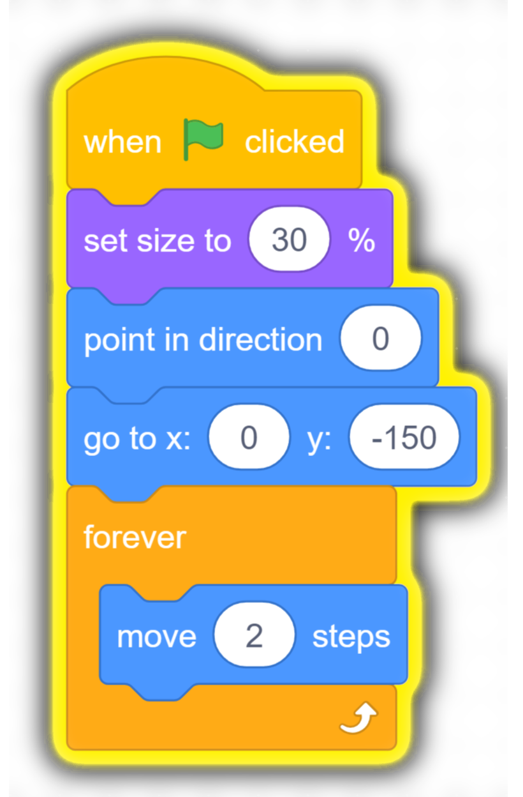
Move Forever
Turtle still moves after reaching ocean or hitting edge

Slide 19
Something In Between
We do not want to stop after moving some number of steps;
We do not want to move forever;
We want to stop after or move until reaching the ocean.

Slide 20
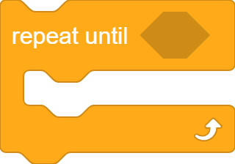
A third Type of Loop
It’s a loop
A hexagon slot for boolean blocks
Code blocks to repeat go inside

Slide 21











Boolean Blocks
Sensing
Operators

Slide 22
Boolean Blocks
Boolean blocks ask Yes or No questions. They are also called conditions that can be True (Yes) or False (No)

Slide 23


Boolean Blocks
Ture
False

Slide 24
Repeat Until…
If the condition is False, repeat
If the condition is True, jump out

Slide 25

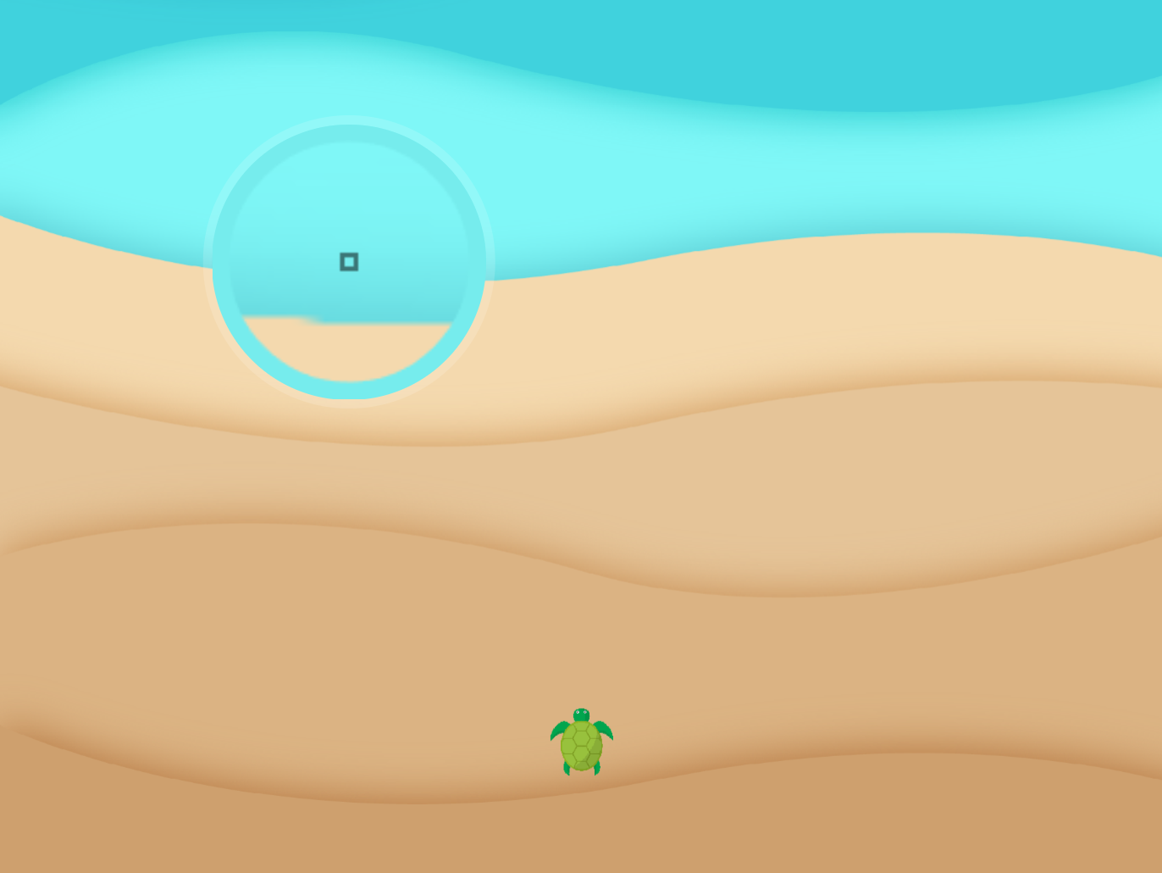
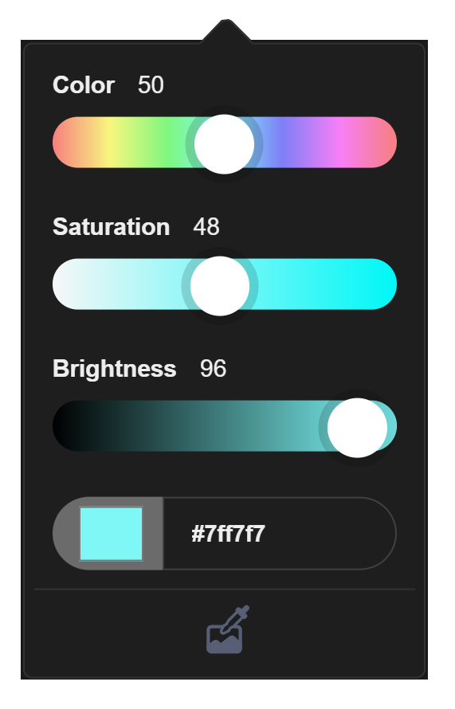
Reached Ocean?
Pick ocean color
Color Picker

Slide 26
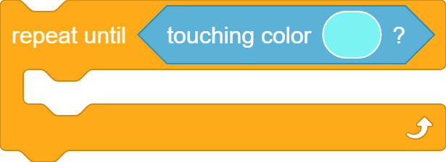
Repeat Until Reaching Ocean

Slide 27
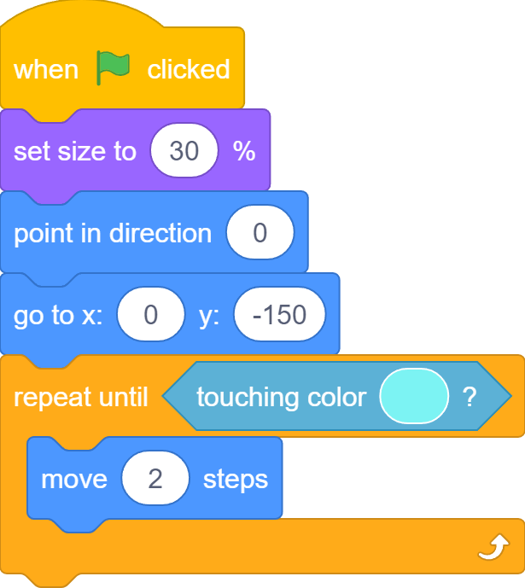
Repeat Until Reaching Ocean

Slide 28
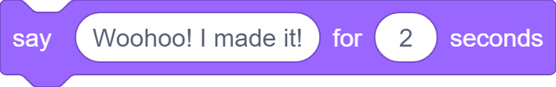
I Made It!

Slide 29
When Key Pressed…

Slide 30
When Key Pressed…

Slide 31
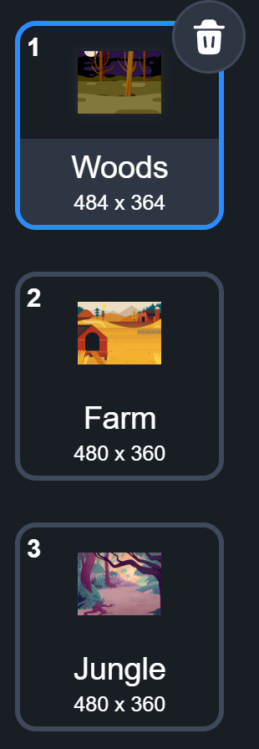
What we learnt…
How to create levels for games using backdrops

Slide 32
Exercises
Can you add even more distractions to the game?
Can you increase the amount of distraction as the players progress from level to level?
What else can you do to make it even harder to find the bug? (think about different effects you can apply to sprites)
Play the game with friends and families to see who is the best bug finder!

Slide 33
Thank you and see you in the next lesson!

